Slide 1
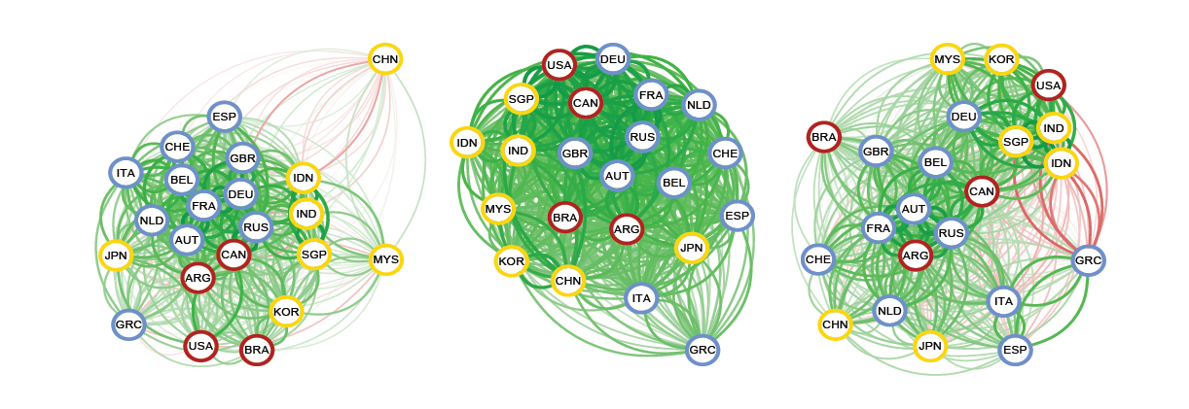
Learning Financial Time-Varying Networks
Manuel Llamas MSc Data Science | Supervisor: Mahesan Niranjan
Abstract
Time-varying networks is recent field developed to explain and model the evolution of networks aiming to understand how, when and why the networks evolve and even leading to predictive models of the phenomena tracked in the network. In network science distinct elements or actors are represented by nodes (or vertices) and the connections between the elements or actors as links (or edges) allowing us to study from how a single element can affect the whole network to even predict which topological changes indicate coming critical events or understand how a network can reshape to minimize contagion between its elements. All of this provides a powerful tool for studying financial networks, giving us a framework to track the evolution of the stock market and understand its behaviour against critical events.
International markets recovered for different epochs. 2005 to 2013 (left), over the 2008 global financial crisis (middle) and during the Greek debt crisis. Blue, red and yellow stand for European, American and Asian markets
Why it matters
Expected Results
Importance of potential outcomes
Time-Varying networks is a very recent field and only one previous work on modelling financial systems as dynamic networks.
Viewing data through a network lens can add substantial new insights helping us to understand better Financial Market’s general topology and behaviour against coming events to find their indicatives and eventually react to avoid contagion between entities..
Understand which individuals of the network are the main ones, that either influence the entire system or a cluster forming part of it (technological companies, car manufacturers…) can also help to avoid contagion effects by shielding them.
Study and understand various algorithms to find the one that best explains the evolution of the financial market.
Apply it to different situations faced by the market and study their structure and changing relationships between entities in a dynamic context.
Study of evolution patterns of the network, setting an scenario to find an explanation to that behaviour.
Extend the algorithm (if possible) to generalize multi-node (adding external variables) and/or multi-level scenarios.
Establishment of a reliable algorithm to model the financial market in a dynamic context and by taking into account external factors to it.
Insight about the Stock Market, mostly how either harmful (2008 crisis) or beneficial (housing bubble) events propagate through the network. Knowing these rewiring patterns can allow us to identify such similar events to come and react in the earliest stages to avoid contagion between entities.
References
Ahmed A and Xing E. (2009) Recovering time-varying networks of dependencies in social and biological studies. PNAS 106 (29) 11878-11883
Durante D. and Dunson D. (2014) Bayesian dynamic financial networks with time-varying predictors. Statistics & Probability Letters, 93, 19-26

